Slide 1
Understanding Angular 3D
Notes:
Welcome and thanks for joining me ☺ My name is Onel…aka…
Let’s start by
In this modern world……
In the last couple of years, browsers have become more powerful and are capable platforms to deliver complex applications and graphics. Most of these, though, are standard 2D graphics. Most modern browsers have adopted WebGL, which allows you to not just create 2D applications and graphics in the browser, but also create beautiful and good performing 3D applications using the capabilities of the GPU. Which means you can directly make use of the processing resources of your graphics card and create high-performance 2D and 3D computer graphics.

Slide 2
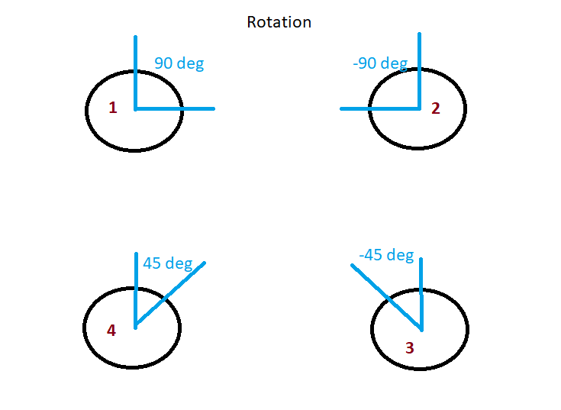
Notes:
I chose this topic to

Slide 3
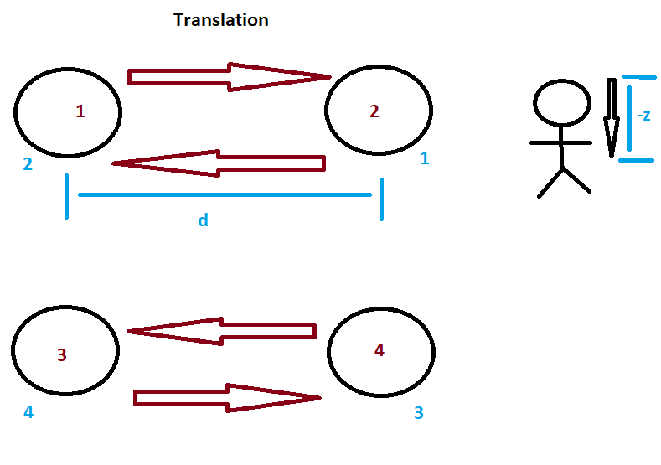

Slide 4
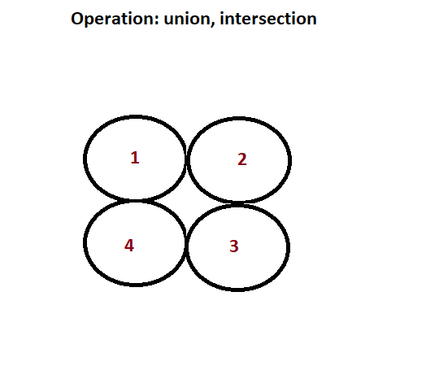

Slide 5
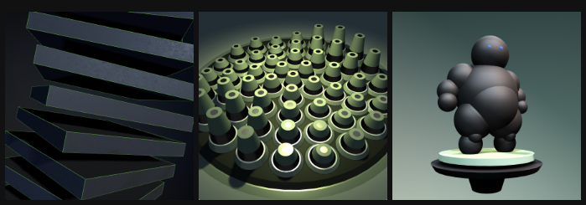
Purpose
to motivate developers to work on 3D programming using their favorite browser
encourage everyone to explore game programming
discover modern browser’s potential
To encourage developers to deep dive into web graphics language and libraries
to refresh terms in 3D world
to appreciate the shape of nature and art
Notes:
I chose this topic to

Slide 6
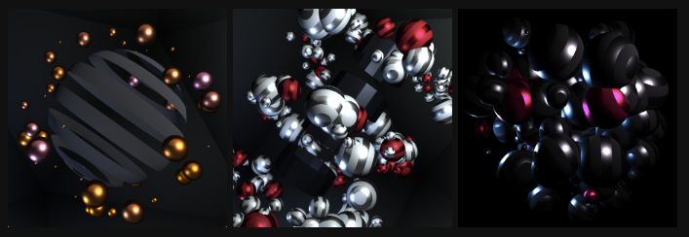
Benefits
Understanding JavaScript 3D is for everyone.
Your imagination is your limit.
Your browser is your best friend.

Slide 7
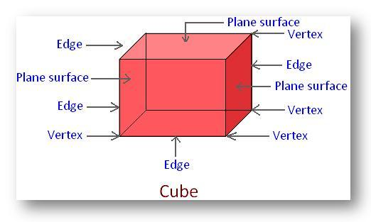
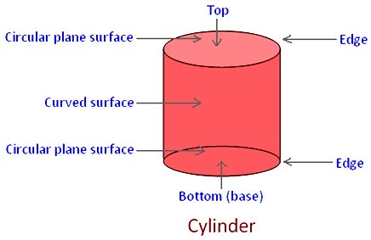
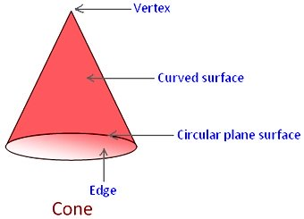
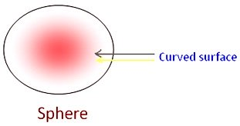
Common Solid Figures
Notes:
In a cube there are 6 plane surfaces. There are 8 vertices and 12 edges. Two adjoining plane – surfaces meet at an edge.
A cylinder stands on a circular plane surface having circular plane surfaces on its top and bottom.
In a cylinder there are 2 plane surfaces and 1 curved surface. There are 2 edges and no vertices.
A cone has one plane circular surface, i.e. its base and only one curved surface. There are 1 edge and 1 vertex.
The ball-like shape is called a sphere. In sphere there is curve surface, no edge and no vertex.

Slide 8
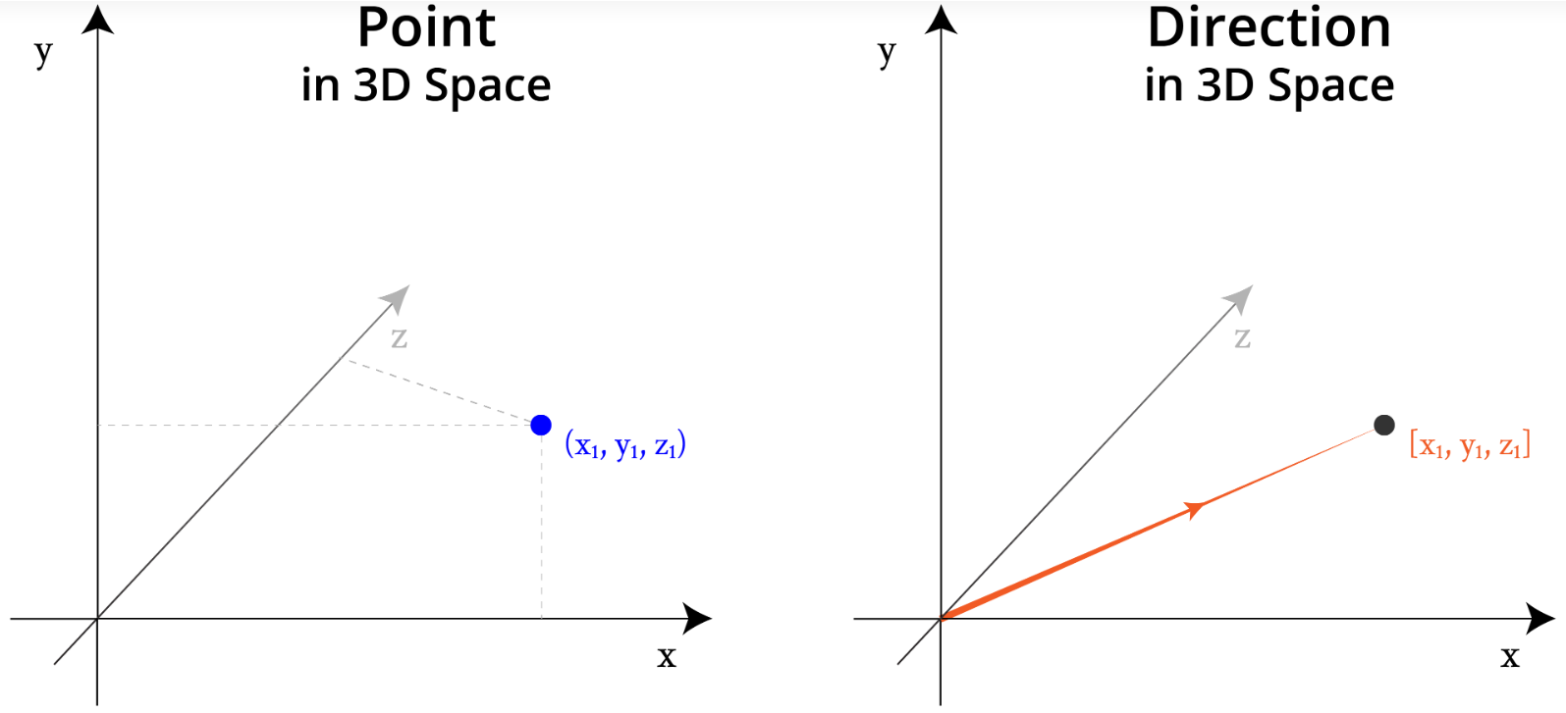
Coordinates review
Notes:
This is the crucial part of 3D design and programming. Most of the 3D objects requires us to position the object we want to render or view.

Slide 9
WebGL
(Web Graphics Library) is a JavaScript API for rendering high-performance interactive 3D and 2D
graphics within any compatible web browser without the use of plug-ins. WebGL does so by introducing an
API that closely conforms to OpenGL ES 2.0 that can be used in HTML5 <canvas> elements.
Notes:
This conformance makes it possible for the API to take advantage of hardware graphics acceleration
provided by the user's device.
Programming WebGL directly, however, is very complex. You need to know the inner details of WebGL and learn a complex shader language to get the most out of WebGL. Three.js provides a very easy to use JavaScript API around the features of WebGL, so you can create beautiful 3D graphics without having to learn WebGL in detail".

Slide 10
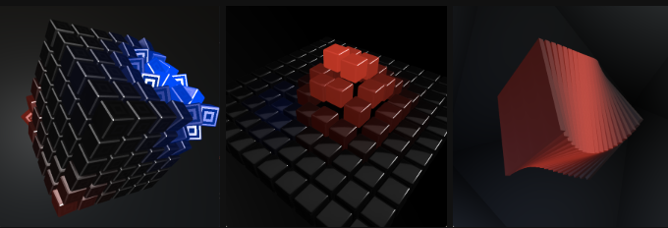
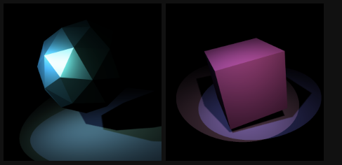
Three.js
Three.js is an open source JavaScript library that's been around since 2010 and allows you to easily create good-looking 3D scenes directly inside your browser
Notes:
For rendering, Three.js uses WebGL.
Three.js was released by Ricardo Cabello known as mrdoob
https://mrdoob.com/projects/htmleditor/

Slide 11
Some of the things that Three.js makes easy:
1. Creating simple and complex 3D geometries
2. Animating and moving objects through a 3D scene
3. Applying textures and materials to your objects
4. Making use of different light sources to illuminate the scene
5. Loading objects from 3D-modeling software
6. Adding advanced postprocessing effects to your 3D scene
7. Working with your own shaders
8. Creating point clouds (dust, rain, etc...)
Notes:
https://threejs.org/examples/webgl_geometry_cube.html
https://threejs.org/examples/webgl_lights_physical.html
https://threejs.org/examples/webgl_loader_collada_skinning.html
https://threejs.org/examples/webgl_geometry_terrain_fog.html
With a couple of lines of JavaScript, you can create anything, from simple 3D models to photorealistic real-time scenes.
Basically, Three.js runs on any of the modern browsers.
It is also possible to run Three.js on mobile devices.

Slide 12
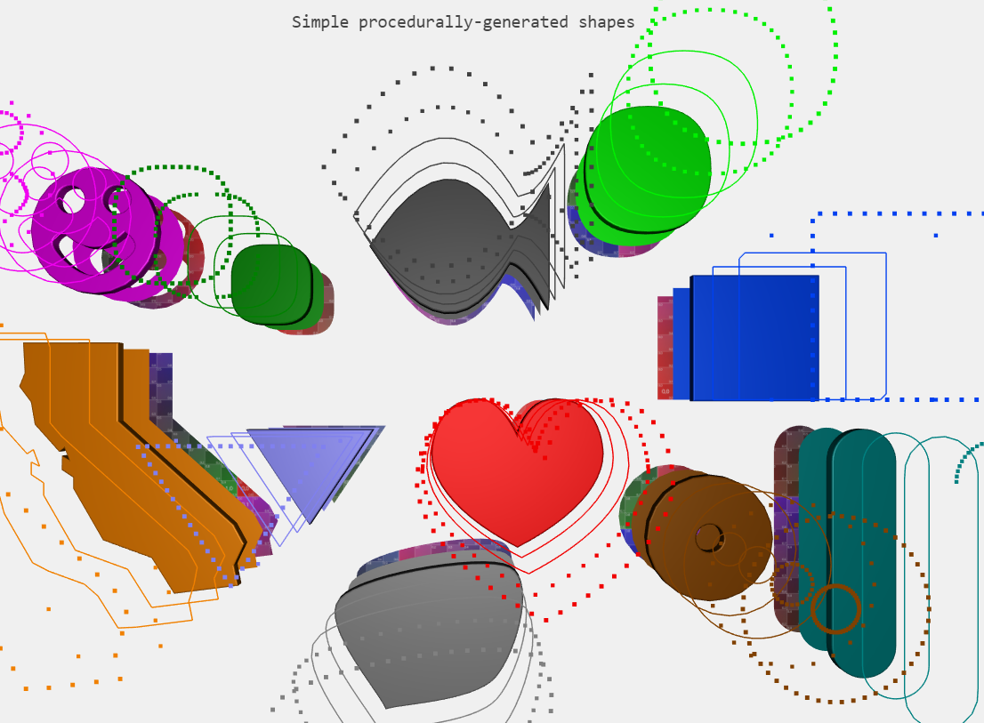
Rendering and viewing a 3D object
Scene
Object
Light
Camera
Renderer
Notes:
The 'scene' is a container that is used to store and keep track of all the objects we want to render and all the lights we want to use. (w/out it there isn't able to render anything)
Scene - also called a scene graph, is a structure that can hold all necessary information of a graphical scene.
Objects - these are the main objects that are rendered from the perspective of the camera: cubes, spheres, and the like. (these are the actors in a movie).
We also create the 'camera'. The 'camera' defines what we'll see when we render a scene.
Next is 'renderer' object. The 'renderer' object is responsible for calculating what the scene object will look like in the browser based on the camera object's angle. We uses 'WebGLRenderer' that uses your graphics card to render the scene.
Another ex. For CSS3DRenderer https://threejs.org/examples/#css3d_periodictable

Slide 13
Materials, Lights, and Shadows
The material is like the skin of the object that defines what the outside of a geometry looks like.
Different materials respond differently to light.
Lights - These have an effect on how materials are shown and used when creating shadow effects.
Notes:
https://threejs.org/examples/webgl_interactive_cubes.html
For example, a skin defines whether a geometry is metallic-looking, transparent, or shown as a wireframe
Without lights, we won't see anything rendered.

Slide 14

Geometries (rendered with triangular Mesh technology)
Circle
Ring
Plane
Shape
Box
Sphere
Cylinder
Torus
TorusKnot
Polyhedron
IcosahedronGeometry
OctahedronGeometry
Text etc
Notes:
Geometry defines the shape of the objects we draw in Three.js. Geometry is made up of a collection of vertices and often faces which combine three vertices into a triangle face.
https://threejs.org/examples/webgl_geometries.html
Mesh technique usually used in face recognition, terrain scanning, and in medical field.

Slide 15
Sample

Slide 16
Gamepad API
The Gamepad API is a way for developers and designers to access and use gamepads and other game controllers.
- Connecting to gamepad
Notes:
3D programming in a browser is best paired with game controls.
HTML5 introduced many of the necessary components for rich, interactive game development. Technologies like <canvas>, WebGL, <audio>, and <video>, along with JavaScript implementations, have matured to the point where they can now support many tasks previously requiring native code.
The Gamepad API introduces new events on the Window object for reading gamepad and controller (hereby referred to as gamepad) state.
I’ll show you how to use the gamepadconnected event in order to display all gamepads connected to the system
Questions
Ask possible app to create
Assignment: try to generate 3D maze

Slide 17
Thank you so much ☺

